Slide 1
Book Recommendation Platform – Project Analysis & Design
Lakshmi Narayana Manukonda
Professional Seminar
COMP-699-B.FA25
Prof. Vladimir Riabov
Rivier University
November 3rd, 2025
1

Slide 2
Introduction
Huge book lists make finding a good next read slow and guessy.
My app loads your CSV/XLSX, maps columns, and builds a searchable index.
Smart suggestions use TF-IDF + cosine similarity (by profile, title, or keyword).
Simple filters (title, author, language, genre, difficulty) + fast results.
Track To-Read/Completed with a live progress chart; all data stays local.
2

Slide 3
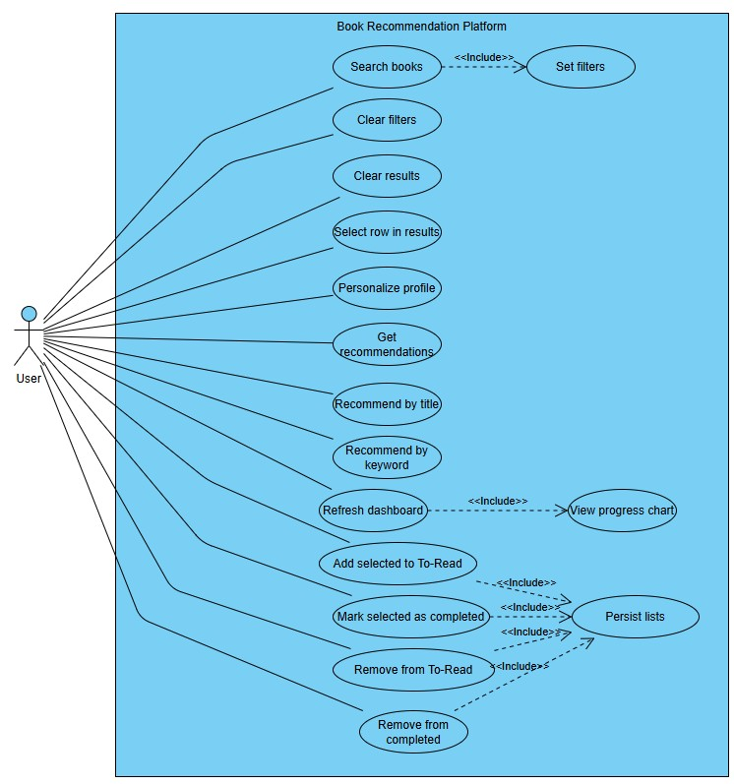
Usecase diagram
3

Slide 4
Usecase diagram explanation
One User interacts with the desktop app to find and manage books.
Search books with Set filters (title, author, language, genre, difficulty) to see results.
Personalize profile and Get recommendations powered by similarity scoring.
Quick discovery via Recommend by title and Recommend by keyword.
Manage reading: Add to To-Read, Mark as Completed, Remove — changes persist to local state.
Refresh dashboard to view progress chart (To-Read vs Completed).
4

Slide 5
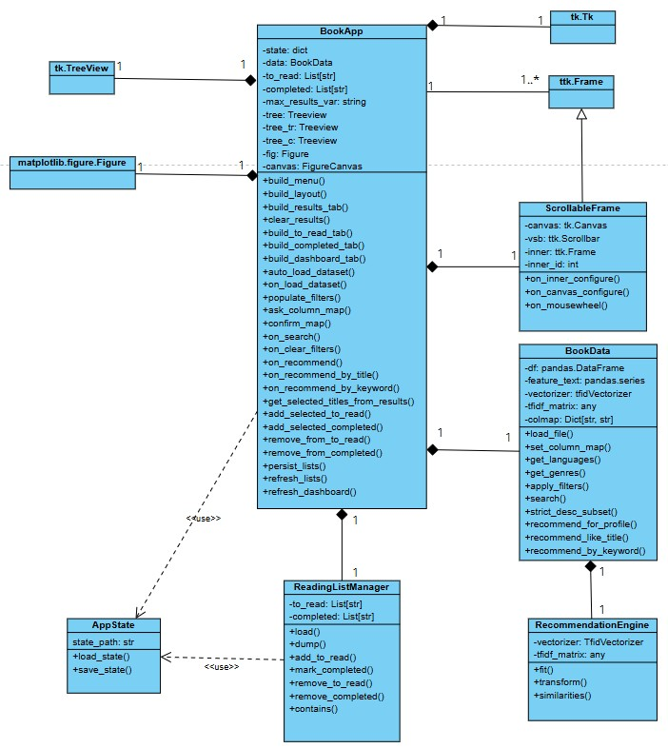
Class Diagram
5

Slide 6
Class diagram explanation
BookApp is the main window: builds menu, sidebar, tabs, handles clicks, and shows results & charts.
BookData loads the CSV/XLSX, maps columns, builds TF-IDF, and provides search/recommend methods.
ScrollableFrame is a reusable scrollable sidebar (Canvas + Scrollbar) used by BookApp.
UI widgets: Treeview lists results/to-read/completed; Matplotlib Figure/Canvas draws the progress chart.
State/persistence: simple JSON save/load for to_read and completed (AppState/ReadingListManager concept).
Relationships: BookApp aggregates UI widgets and uses one BookData; helpers are used (not subclassed) to keep UI, data, and storage separate.
6

Slide 7
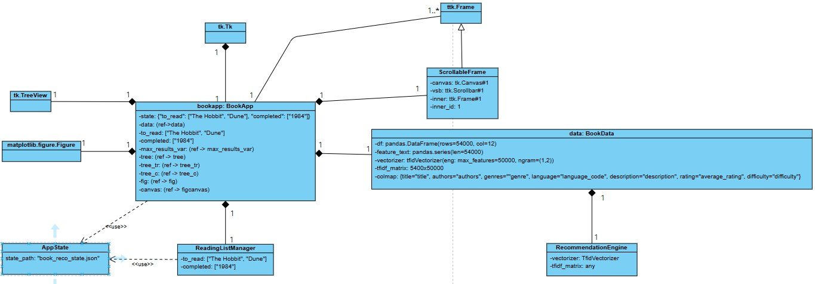
Object Diagram
7

Slide 8
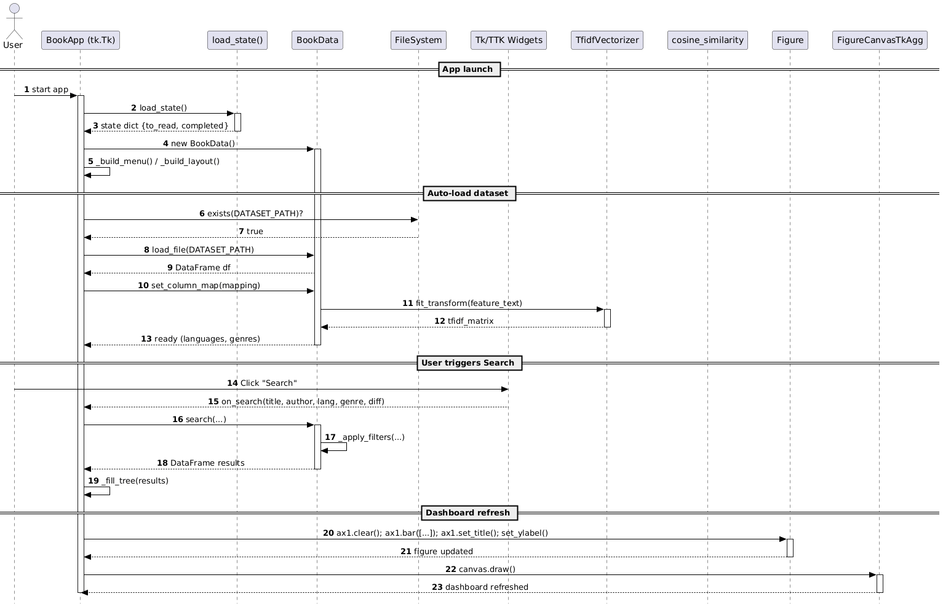
Sequence Diagram
8

Slide 9
Sequence diagram explanation
On launch, BookApp loads saved state (to-read/completed), creates BookData, and builds the menu/layout.
It auto-checks the dataset path, loads the CSV/XLSX, maps columns, and fits TF-IDF to build a search index.
Filters (languages, genres) are populated and the UI is ready.
When the user clicks Search, BookApp calls search(...); BookData applies filters and returns a DataFrame of matches.
BookApp fills the results table with titles/authors/language/rating and shows scores when present.
On updates, the Dashboard clears and redraws the bar chart (to-read vs completed) and refreshes the canvas.
9

Slide 10
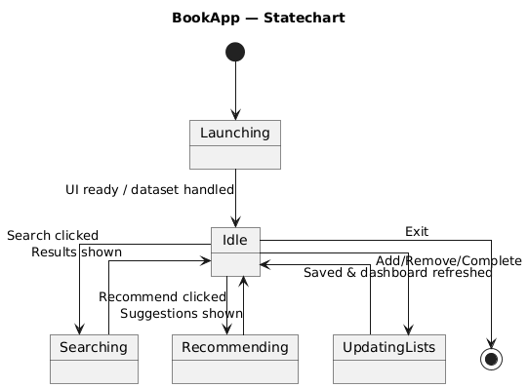
State-Chart Diagram
10

Slide 11
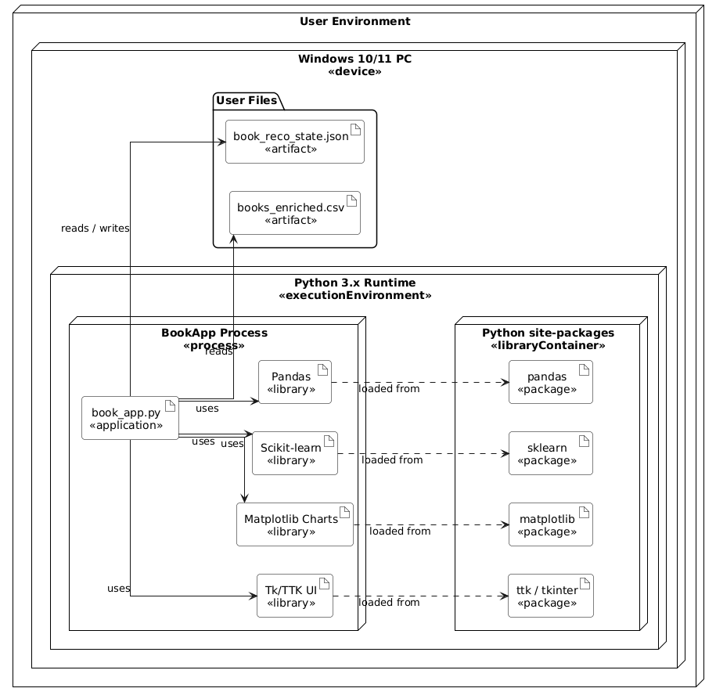
Deployment Diagram
11

Slide 12
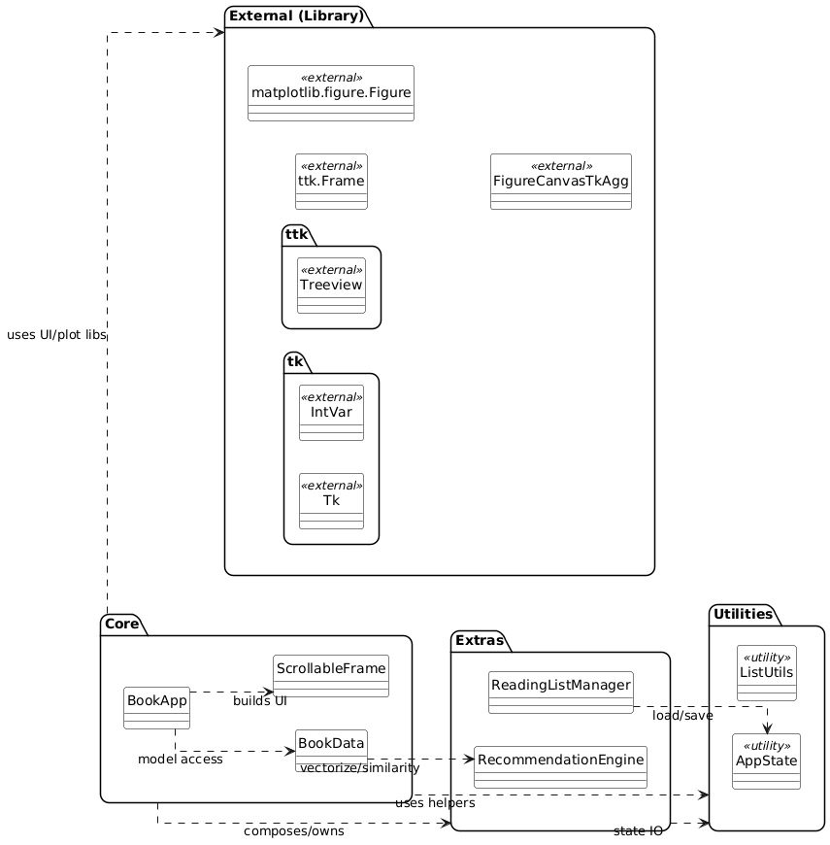
Package Diagram
12

Slide 13
Sequence diagram explanation
Layers: The app is split into Core, Extras, Utilities, and External (library) packages to keep UI, logic, and helpers cleanly separated.
Core: BookApp builds the UI (with ScrollableFrame) and accesses data through BookData. This is the main orchestrator layer.
Extras: RecommendationEngine provides TF-IDF + similarity services that BookData calls; ReadingListManager handles To-Read/Completed list operations.
Utilities: AppState (and ListUtils) handle load/save of JSON state and small list helpers, keeping persistence out of the UI.
External libs: Tk/Ttk widgets (Tk, Frame, Treeview, IntVar) and Matplotlib (Figure, FigureCanvasTkAgg) are used only through BookApp/UI code; domain logic doesn’t depend on them.
Dependencies: One-way arrows: BookApp → BookData → RecommendationEngine, and BookApp → AppState for state I/O. This avoids cycles and makes testing and maintenance easier.
13

Slide 14
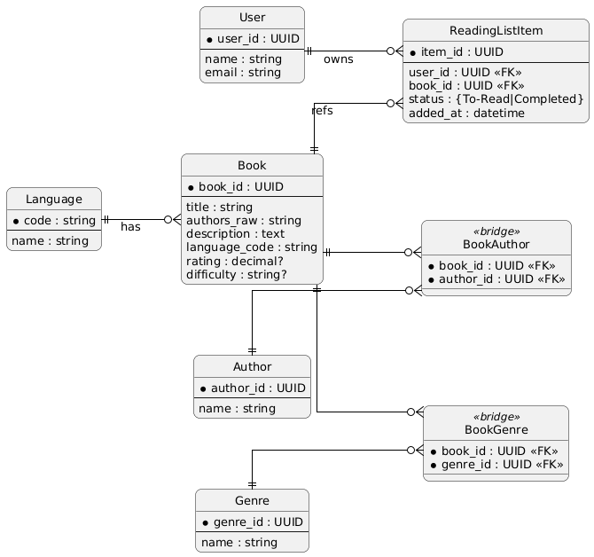
ER Diagram
14

Slide 15
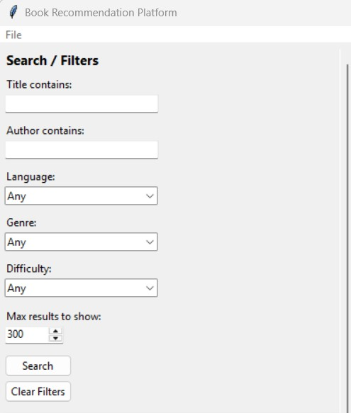
Draft of User Interface
15

Slide 16
Reference
Visual Paradigm Online. (n.d.). VP Online. https://online.visual-paradigm.com
16

Slide 17
Thank you
17

